Slide 1
Announcements
Final Contest: Pacman Capture the Flag (optional)
Closes tonight at midnight
P5 Machine Learning
Optional, as in: lowest project will be dropped
Due Friday 12/13 at 5pm

Slide 2
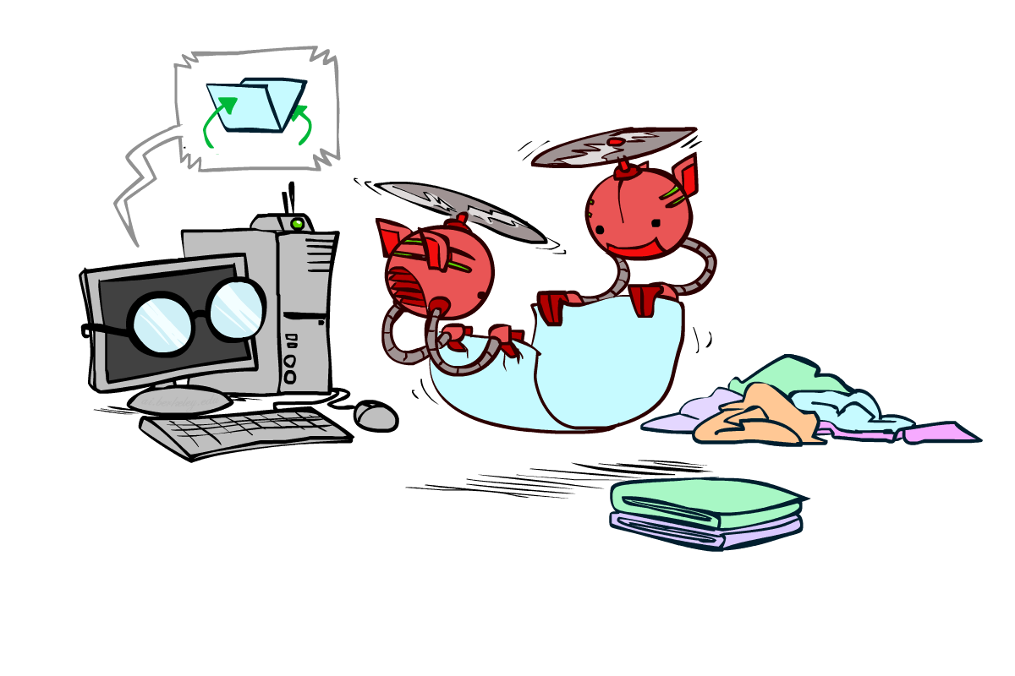
CS 188: Artificial Intelligence
Advanced Applications: Computer Vision and Robotics *
Instructors: Dan Klein and Pieter Abbeel --- University of California, Berkeley
[These slides were created by Dan Klein and Pieter Abbeel for CS188 Intro to AI at UC Berkeley. All CS188 materials are available at http://ai.berkeley.edu.]
Notes:
Please retain proper attribution, including the reference to ai.berkeley.edu. Thanks!

Slide 3

Computer Vision

Slide 4
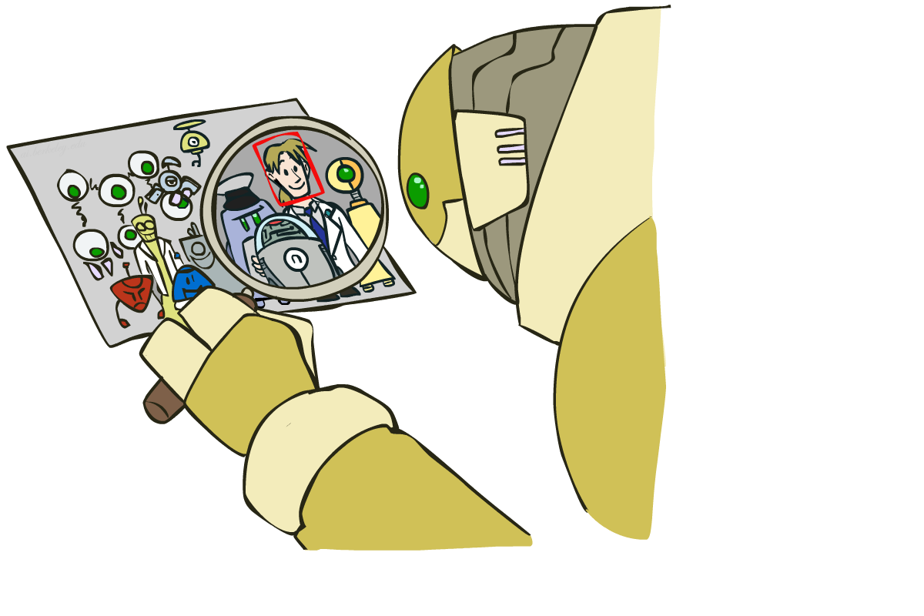
Object Detection

Slide 5
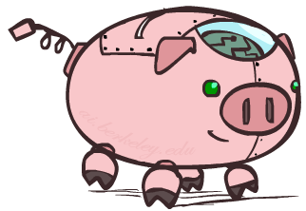
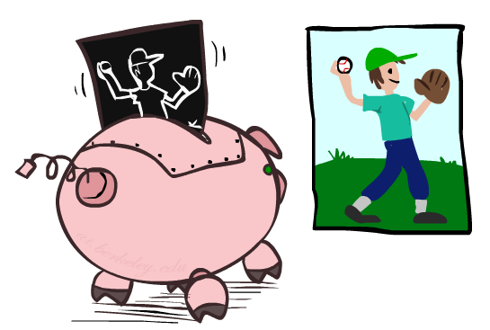

Object Detection Approach 1: HOG + SVM

Slide 6
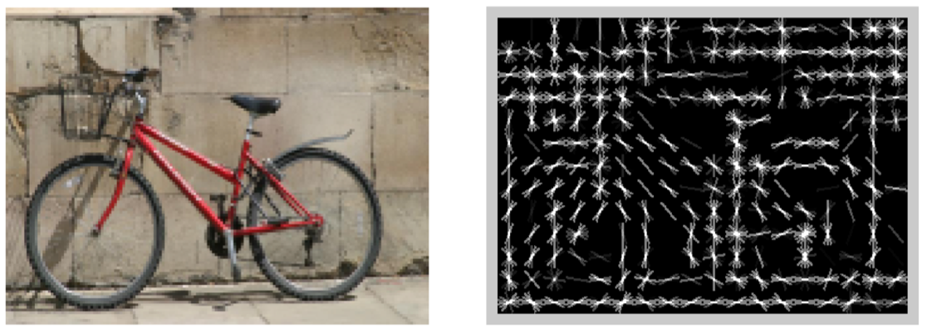
Features and Generalization
[Dalal and Triggs, 2005]

Slide 7
Features and Generalization
Image
HoG

Slide 8
Training
Round 1
Training set =
Positive examples: from labeling
Negative examples: random patches
preliminary SVM
Round 2 (“bootstrapping” or “mining hard negatives”)
Training set =
Positive examples: from labeling
Negative examples: patches that have score >= -1
→ final SVM

Slide 9
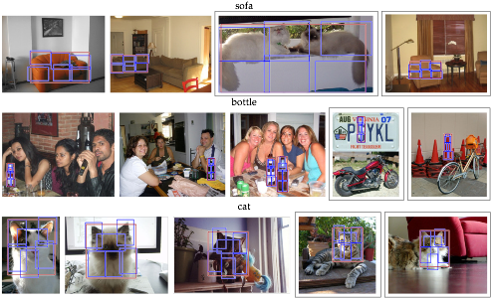
State-of-the-art Results
sofa
bottle
cat
[Girschik, Felzenszwalb, McAllester]

Slide 10
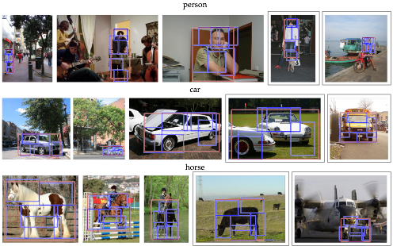
State-of-the-art Results
person
car
horse
[Girschik, Felzenszwalb, McAllester]

Slide 11
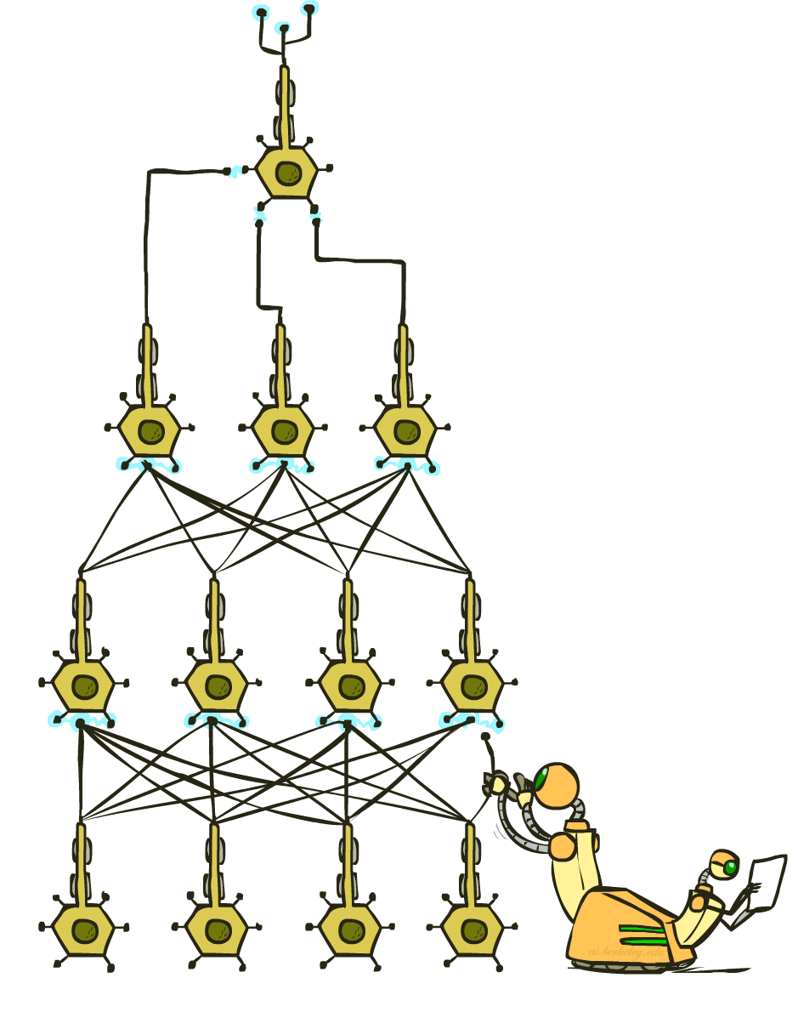
Object Detection Approach 2: Deep Learning

Slide 12

How Many Computers to Identify a Cat?
“Google Brain”
[Le, Ng, Dean, et al, 2012]

Slide 13
Perceptron
w₁
f₁
Σ
w₂
>0?
f₂
w₃
f₃

Slide 14
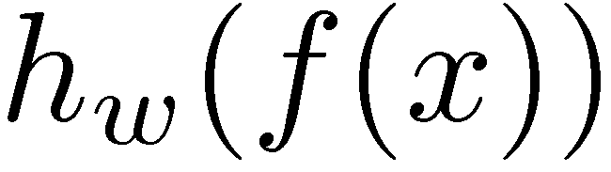
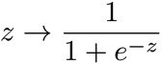
Two-Layer Neural Network
w₁₁
Σ
w₂₁
>0?
w₃₁
w₁
f₁
w₁₂
Σ
Σ
w₂₂
>0?
w₂
f₂
w₃₂
w₃
f₃
w₁₃
Σ
w₂₃
>0?
w₃₃

Slide 15
N-Layer Neural Network
Σ
Σ
Σ
>0?
>0?
>0?
…
f₁
Σ
Σ
Σ
Σ
>0?
>0?
>0?
f₂
…
f₃
Σ
Σ
Σ
>0?
>0?
…
>0?

Slide 16
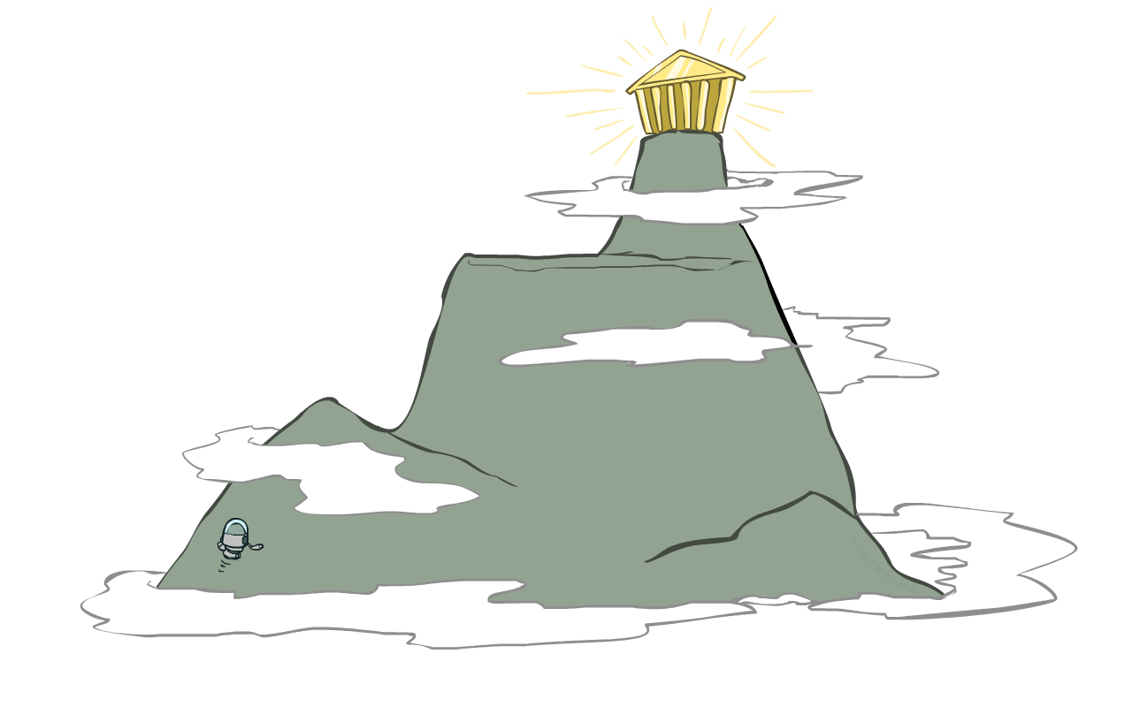
Hill Climbing
Simple, general idea:
Start wherever
Repeat: move to the best neighboring state
If no neighbors better than current, quit
Neighbors = small perturbations of w
Property
Many local optima
--> How to find a good local optimum?

Slide 17

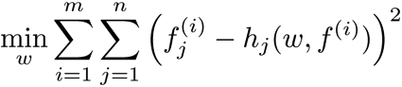
Auto-Encoder (Crude Idea Sketch)
Σ
>0?
f₁
f₁
Σ
>0?
Σ
f₂
>0?
f₂
Σ
>0?
Σ
f₃
>0?
f₃

Slide 18
Training Procedure: Stacked Auto-Encoder
Auto-encoder
Layer 1 = “compressed” version of input layer
Stacked Auto-encoder
For every image, make a compressed image (= layer 1 response to image)
Learn Layer 2 by using compressed images as input, and as output to be predicted
Repeat similarly for Layer 3, 4, etc.
Some details left out
Typically in between layers responses get agglomerated from several neurons (“pooling” / “complex cells”)

Slide 19
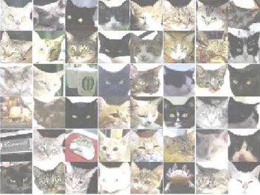
Final Result: Trained Neural Network
Σ
Σ
Σ
>0?
>0?
>0?
…
f₁
Σ
Σ
Σ
f₂
>0?
>0?
>0?
…
…
…
…
…
f_{N}
Σ
Σ
Σ
>0?
>0?
…
>0?

Slide 20
Final Result: Trained Neural Network
Σ
Σ
Σ
>0?
>0?
>0?
…
f₁
Σ
Σ
Σ
Σ
f₂
>0?
>0?
>0?
…
…
…
…
…
f_{N}
Σ
Σ
Σ
>0?
>0?
…
>0?

Slide 21
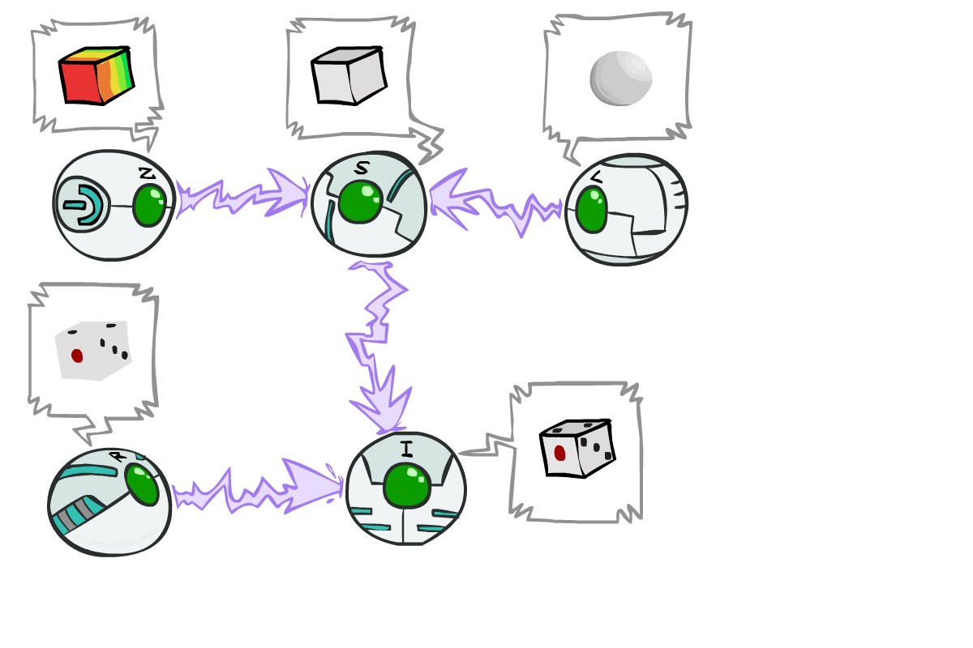
Shapes, Paint, and Light from an Image

Slide 22
Depth, Paint, and Light from an Image
Depth (Z)
Light (L)
Paint (Reflectance)
Image (I)

Slide 23

Depth, Paint, and Light from an Image
Depth (Z)
Light (L)
Paint (Reflectance)
Image (I)
To recover Depth, Light, and Paint from a given image i:
Challenge 1: P(Z), P(L), P(R) --- how about P(S | Z, L) and P(I | S, R) ?
Challenge 2: Efficient inference
Inference: argmax_{Z L R} P (Z, L, R | i )

Slide 24
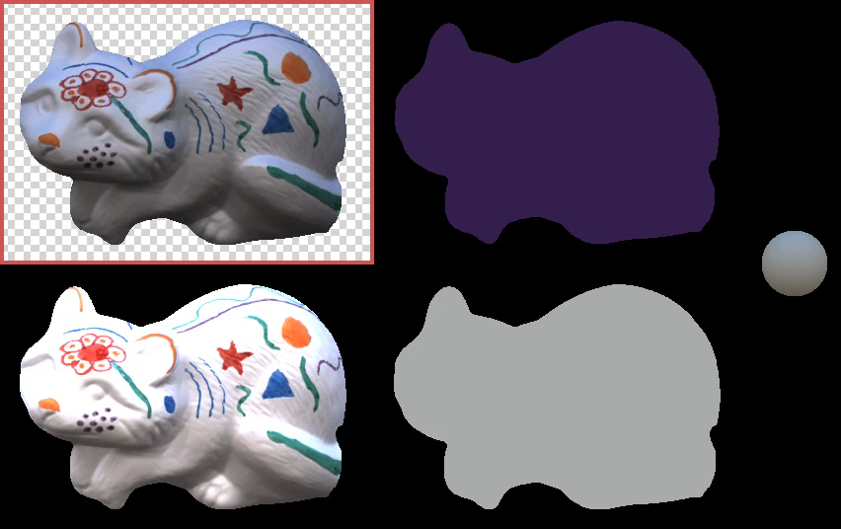
Inference in Action
[Barron, Malik, 2012]
[VIDEO: solve-1.mov]

Slide 25
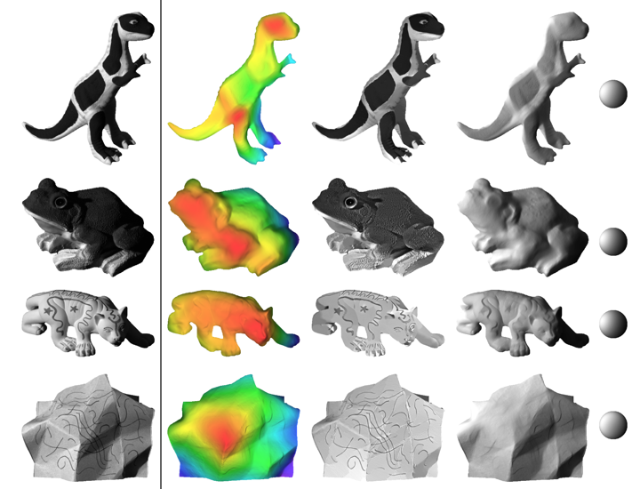
Example Results
[Barron, Malik, 2012]

Slide 26
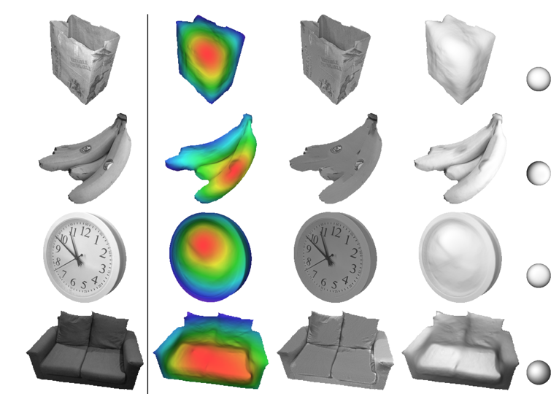
Example Results
[Barron, Malik, 2012]

Slide 27
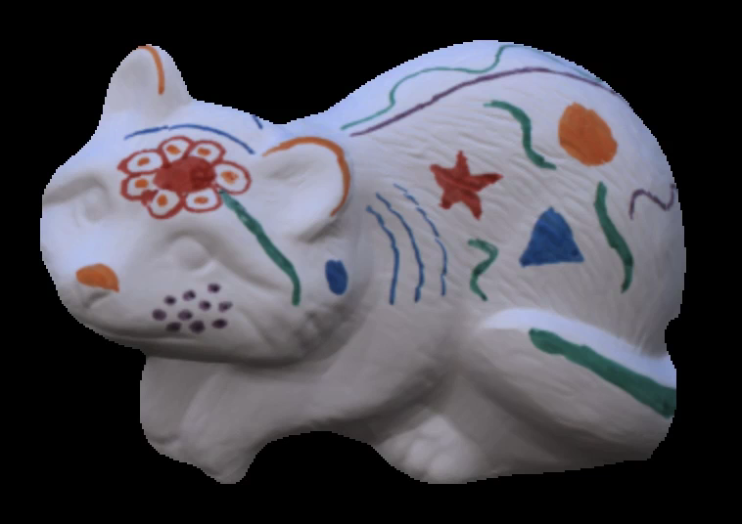
Example Results: Graphics
[Barron, Malik, 2012]
[VIDEO: output-1.mov]

Slide 28

Robotics

Slide 29
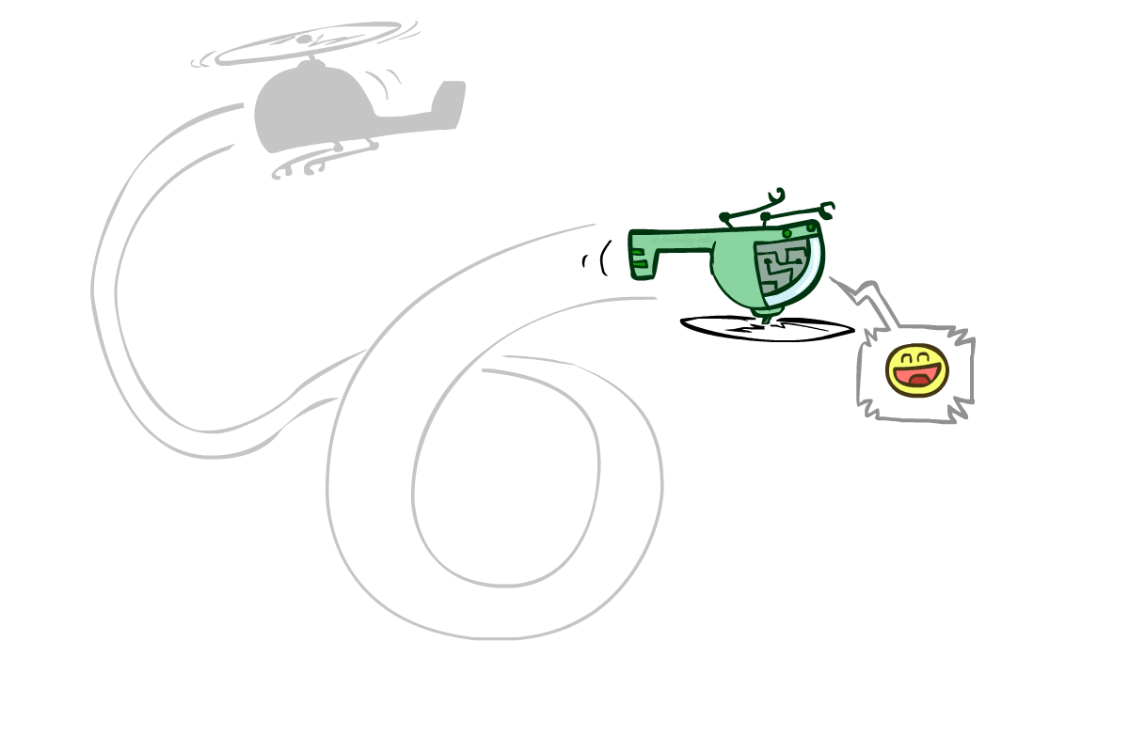
Robotic Helicopters

Slide 30
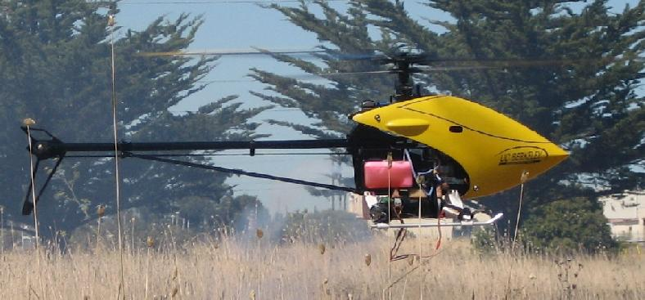
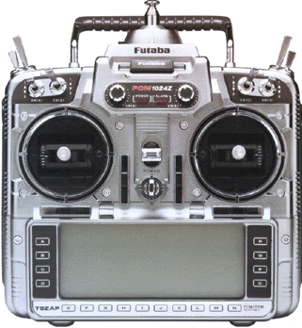
Autonomous Helicopter Flight
Key challenges:
Track helicopter position and orientation during flight
Decide on control inputs to send to helicopter
TexPoint fonts used in EMF.
Read the TexPoint manual before you delete this box.: AAAAAA
Notes:
The helicopter is controlled via a
4-dimensional action space:
\begin{enumerate}
\item The latitudinal (left-right) and longitudinal
(front-back) cyclic pitch controls. They are also often referred to
by elevator and aileron. They change the pitch angle of
the main rotor throughout each cycle and can thereby cause the
helicopter to pitch forward/backwards or to roll sideways. By
pitching and rolling the helicopter, the pilot can affect the
direction of the main thrust, and hence the direction in which the
helicopter moves
\footnote{In a bit more detail: the main rotor pitch angle
can be expressed as $u_4 + u_1 \sin \theta + u_2 \cos \theta$ where $\theta$ is the phase of the main rotor in its rotation around the vertical axis of the helicopter. The pitch angle of the main rotor affects the force generated by the main rotor, which, through the main rotor hub and shaft, result in pitch and roll moments on the helicopter.}%
%
\item $\action_3$:
The yaw rate input commands a reference yaw rate (rotation rate of the helicopter about its vertical axis) to an on-board control system. The on-board control system runs a PID controller which controls the tail rotor pitch, which in turn changes tail rotor
thrust, which in turn---as the tail rotor is offset from the center of gravity of the helicopter---results in controlling the rotation of the helicopter about its vertical axis. The on-board control system uses a Futaba gyro to sense the helicopter's yaw rate.
%
\item $\action_4$: The main rotor collective pitch control changes the
pitch angle of the main rotor's blades, by rotating the blades
around an axis that runs along the length of the blade. The
resulting amount of upward thrust (generally) increases with this
pitch angle; thus this control affects the main rotor's thrust.
%
\end{enumerate}

Slide 31
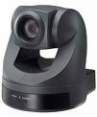
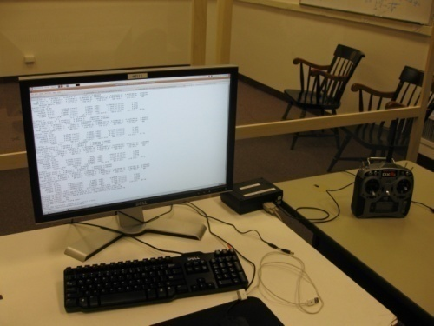
Autonomous Helicopter Setup
On-board inertial measurement unit (IMU)
Position
Send out controls to helicopter
Notes:
GPS does not work when flying upside down … [except when sustained upside down for a long time, then it re-acquires lock to the satellite signals]
Inertial unit measures: 3-axis gyro (angular rates), 3-axis magnetometer (=3D compass), 3-axis accelerometer (accelerometer measures zero in free-fall --- in other words: it measures gravity + acceleration w.r.t. earth fixed frame; hence when a helicopter is hovering, it roughly measures the gravity vector)
Mag and accel give orientation information
Gyro derivative of orientation

Slide 32


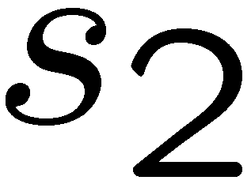



HMM for Tracking the Helicopter
State:
Measurements: [observation update]
3-D coordinates from vision, 3-axis magnetometer, 3-axis gyro, 3-axis accelerometer
Transitions (dynamics): [time elapse update]
s_{t+1} = f (s_{t}, a_{t}) + w_{t} f: encodes helicopter dynamics, w: noise

Slide 33
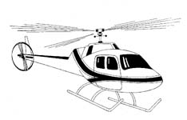
Helicopter MDP
State:
Actions (control inputs):
a_{lon} : Main rotor longitudinal cyclic pitch control (affects pitch rate)
a_{lat} : Main rotor latitudinal cyclic pitch control (affects roll rate)
a_{coll} : Main rotor collective pitch (affects main rotor thrust)
a_{rud} : Tail rotor collective pitch (affects tail rotor thrust)
Transitions (dynamics):
s_{t+1} = f (s_{t}, a_{t}) + w_{t}
[f encodes helicopter dynamics]
[w is a probabilistic noise model]
Can we solve the MDP yet?
Notes:
\phi, \theta, \psi: roll, pitch, yaw angles
P, q, r: roll rate, pitch rate, yaw rate --- these are the angular rates expressed in a coordinate frame attached to the helicopter [they are not equal to \dot{\phi} etc.]
N,e,d: north east down coordinates
U,v,w: velocity in a coordinate frame attached to the helicopter: forward, sideways, downward
Why controlling pitch angle? Combination of reasons:
RC scale: much faster reaction [compared to spinning up down an engine + the range of an engine is usually limited, so would need variable transmission for wide variation of thrust]
Full scale: much faster reaction + otherwise helicopter would fall apart [i.e., variable rotor speed would mean variable frequencies of vibrations induced by the rotor, which would mean you’d have to build a mechanical system with no resonance frequencies anywhere in that range, this is really hard (perhaps impossible)]

Slide 34
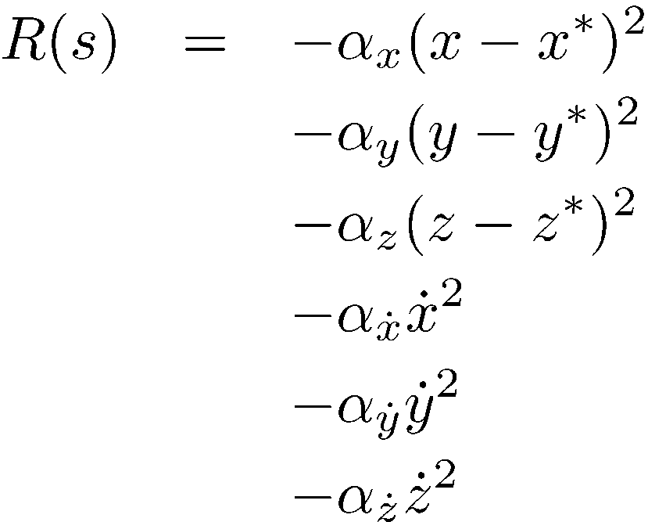
Problem: What’s the Reward?
Reward for hovering:

Slide 35
Problem: What’s the Reward?
Rewards for “Flip”?
Problem: what’s the target trajectory?
Just write it down by hand?

Slide 36
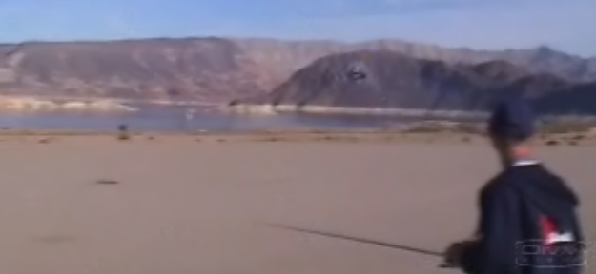
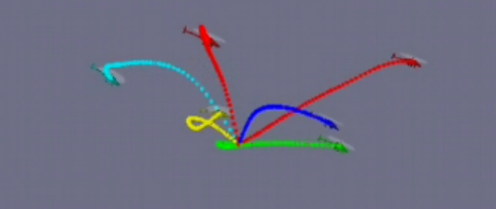
Helicopter Apprenticeship?

Slide 37
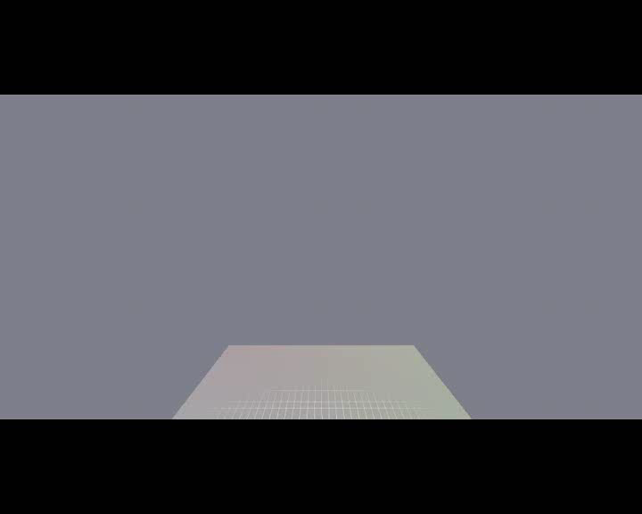
Demonstrations
[VIDEO: airshow_unaligned.wmv]

Slide 38
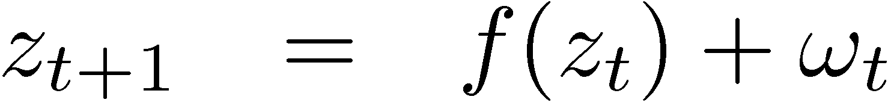


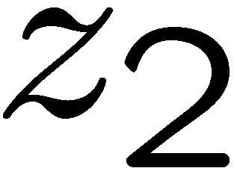
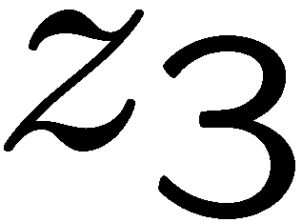


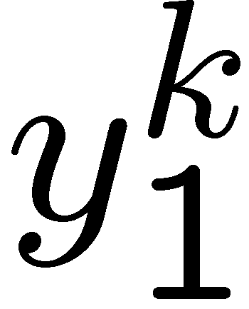
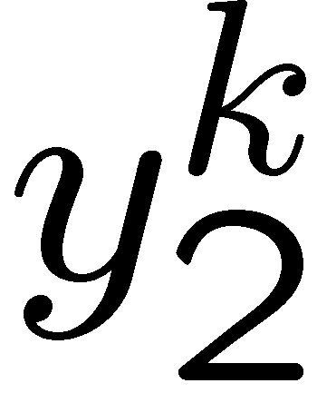
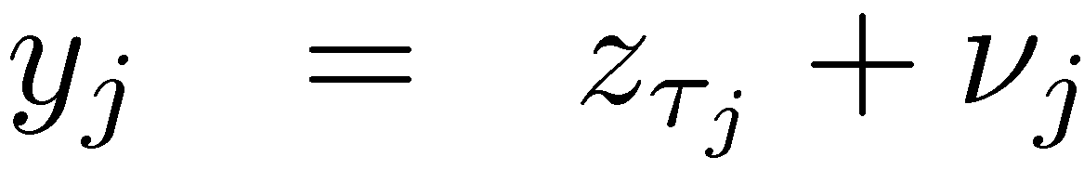

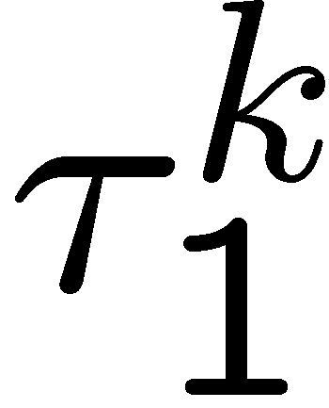
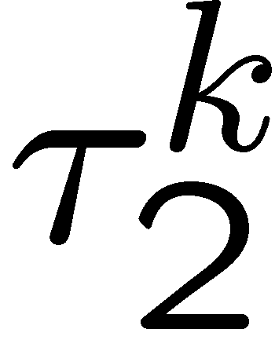
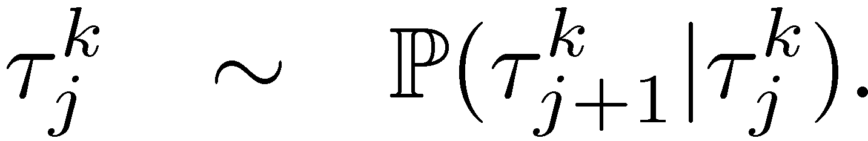
Probabilistic Alignment using a Bayes’ Net
Intended trajectory
Expert demonstrations
Time indices
Intended trajectory satisfies dynamics.
Expert trajectory is a noisy observation of one of the hidden states.
But we don’t know exactly which one.
[Coates, Abbeel & Ng, 2008]
Notes:
To address these problems, we’re first going to propose a generative model for the expert’s suboptimal demonstrations.
We assume that that is some “hidden” intended trajectory, represented here by the variables ‘z’
(1) and that this trajectory follows a nonlinear dynamical system with gaussian noise.
(2) We also have a sequence of states from each expert demonstration, which we model as independent observations of one of the hidden trajectory states.
(3) Unfortunately, we don’t know _which_ hidden state corresponds to each of the demonstration states because the demonstrations occur at different rates.
So, we assume that there is some unknown set of time indices, the taus, that match these observations to the hidden states.
For instance, y1 could be an observation of z1, z2, or z3. And the variable tau1 tells us which of these is the case.

Slide 39

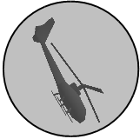
Learning a Trajectory
Hidden
Demo 1
Demo 2
HMM-like generative model
Dynamics model used as HMM transition model
Demos are observations of hidden trajectory
Problem: how do we align observations to hidden trajectory?
Abbeel, Coates, Ng, IJRR 2010

Slide 40


Probabilistic Alignment using a Bayes’ Net
Hidden
Demo 1
Demo 2
Dynamic Time Warping
(Needleman&Wunsch 1970, Sakoe&Chiba, 1978)
Extended Kalman filter / smoother
Abbeel, Coates, Ng, IJRR 2010

Slide 41
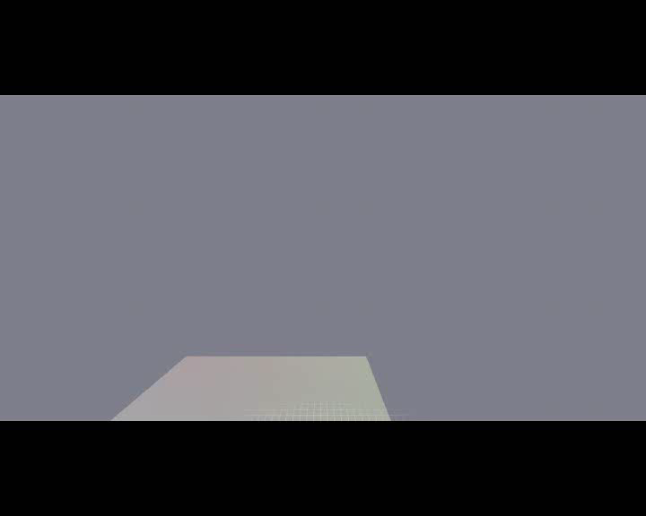
Aligned Demonstrations
[VIDEO: airshow_unaligned.wmv]

Slide 42
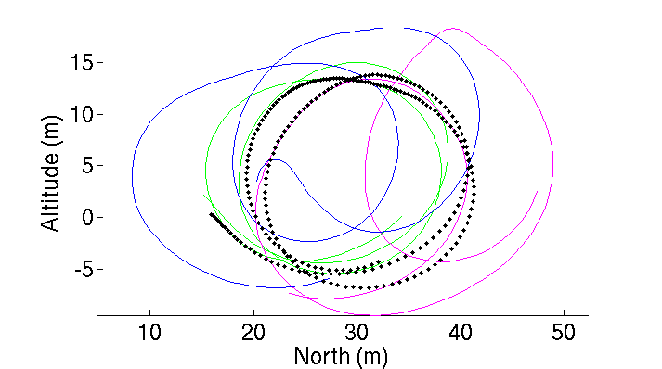
Alignment of Samples
Result: inferred sequence is much cleaner!

Slide 43
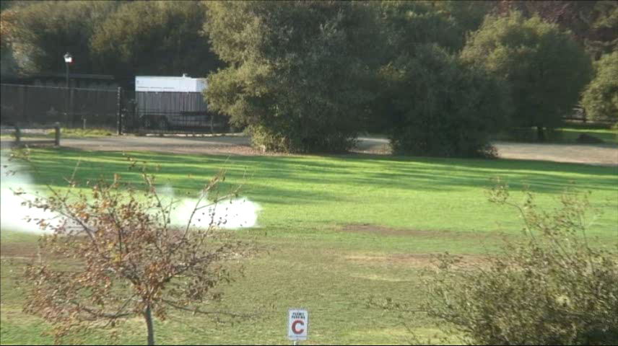
Final Behavior
[VIDEO: airshow_trimmed.wmv]
[Abbeel, Coates, Quigley, Ng, 2010]

Slide 44
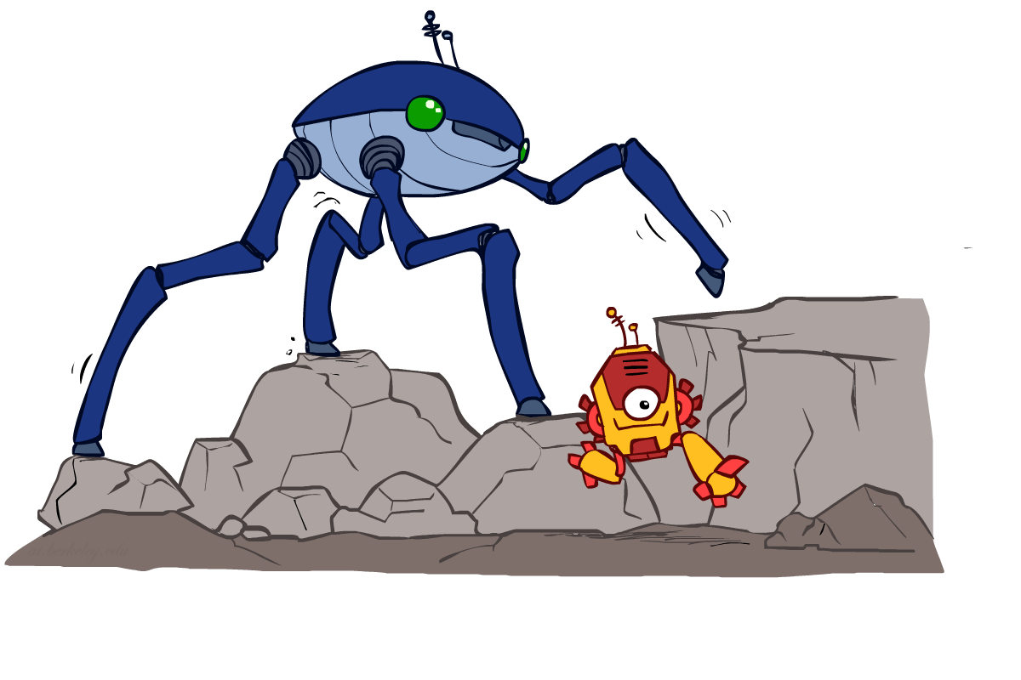
Legged Locomotion

Slide 45
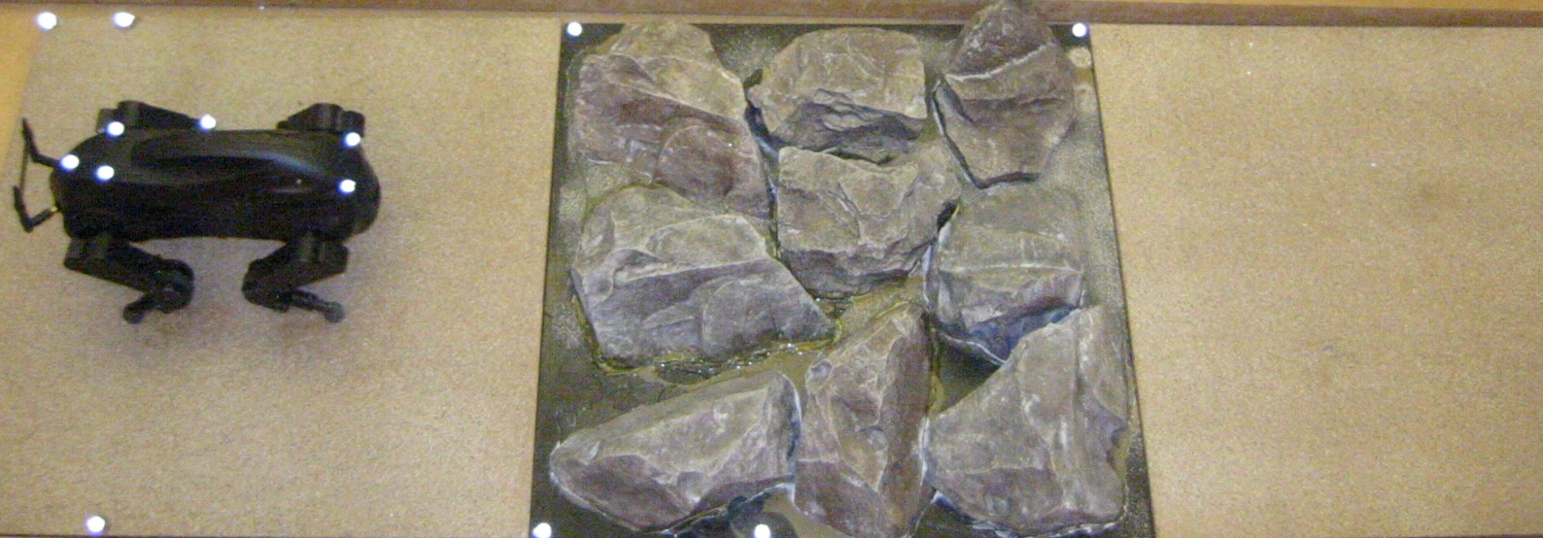
Quadruped
Low-level control problem: moving a foot into a new location → search with successor function ~ moving the motors
High-level control problem: where should we place the feet?
Reward function R(x) = w . f(s) [25 features]
[Kolter, Abbeel & Ng, 2008]
Notes:
Height differential of terrain.
Gradient of terrain around each foot.
Height differential between feet.
… (25 features total for our setup)

Slide 46

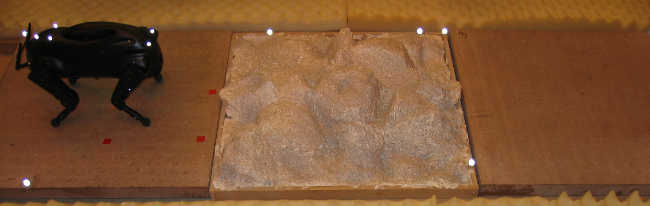
Experimental setup
Demonstrate path across the “training terrain”
Run apprenticeship to learn the reward function
Receive “testing terrain”---height map.
Find the optimal policy with respect to the learned reward function for crossing the testing terrain.
[Kolter, Abbeel & Ng, 2008]

Slide 47
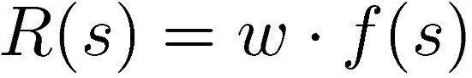
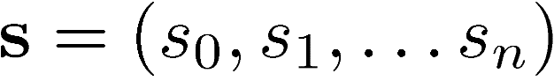
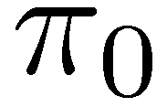
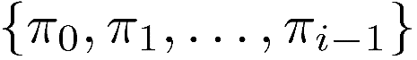
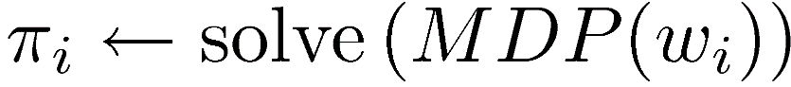
Apprenticeship Learning
Goal: learn reward function from expert demonstration
Assume
Get expert demonstrations
Guess initial policy
Repeat:
Find w which make the expert better than
Solve MDP for new weights w:

Slide 48
Apprenticeship Learning
Goal: learn reward function from expert demonstration
Assume
Get expert demonstrations
Guess initial policy
Repeat:
Find w which make the expert better than
Solve MDP for new weights w:

Slide 49


Personal Robotics

Slide 50

PR2 (autonomous)

Slide 51

Darpa Robotics Challenge
Disaster response (e.g., Fukushima)
E.g., Get into car, drive it, get out, open door, enter building, climb ladder, traverse industrial walkway, use tool to break a panel, locate and close a valve, replace a cooling pump
Competition / Prizes
Simulation competition (June 2013)
Prize: Petman
Real robot (petman) competition (November 2014)
Prize: $ 2M
Notes:
http://www.wired.com/dangerroom/2012/10/darpa-rescue-robot/

Slide 52
Petman
http://www.wired.com/dangerroom/2012/10/darpa-rescue-robot/

Slide 53
Next Time
Final Contest results
Robot butlers
Where to go next to learn more about AI

